Slide 1
Introduction to this slide deck / Disclaimer
This slide deck has been provided by the CDE network of SDC to serve as inspiration for CEDRIG trainings.
The slide deck or parts thereof may be used for CEDRIG training courses.
Use is at your own risk. The SDC accepts no liability in connection with the use of this presentation or parts thereof.

Slide 2

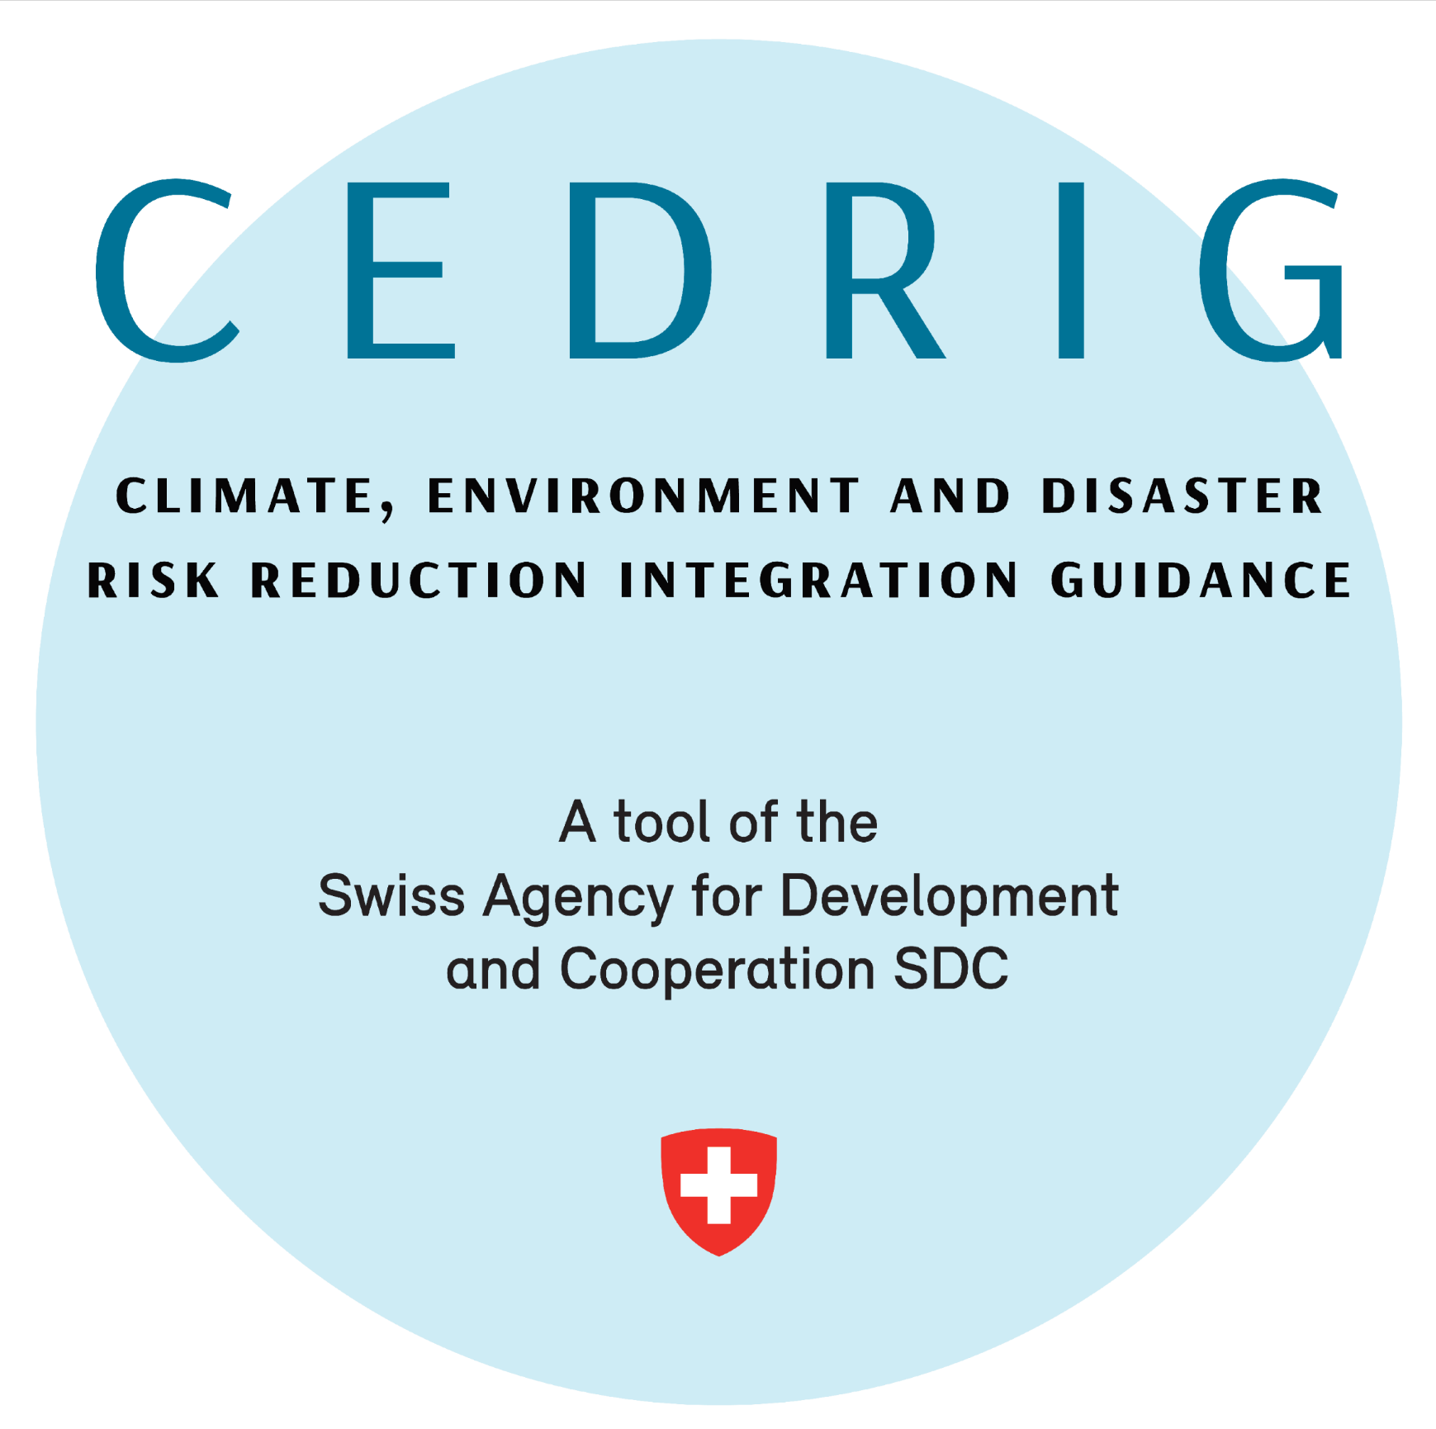


Slide 3
CEDRIG - the SDC mainstreaming tool
What:
Process tool: guides through a process to identify potential risks and impacts linked to climate, environment and natural hazards
For what:
Strategies, programmes and projects of all kind of sectors
Planned or ongoing interventions
Output:
PDF report will be created for each case study
Notes:
CEDRIG stimulates the process of project/strategy development and helps identifying adequate mesaures;
Instrument for development and humanitarian actors

Slide 4
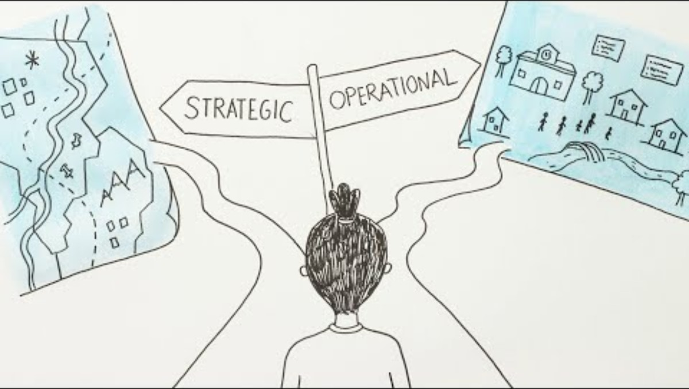
CEDRIG - Introduction

Slide 5
CEDRIG: What are we trying to find out?
Are the domains of the planned cooperation strategy considering the impacts of climate change on economic development?
Is the rural economic development programme sufficiently incorporating possible environmental risks and resulting changes in work and income structures of communities? Is it possibly triggering the increase of GHG emissions?
Is the master plan for preserving landscape reserves and forest areas aware of possible future changes in rainfall patterns in the region?
Is your horticulture project to advance income and food security incorporating possible changes in rainfall patterns and yield projections? Are planned activities possibly triggering the increase of GHG emissions?
Does the planned construction of a water treatment plant and sewer system have potential negative impact on greenhouse gas emissions or the environment?
Is your health project taking into account possible changes in disease patterns due to climate change or health risks from environmental degradation?
etc.
Notes:
CEDRIG is relevant in all sectors of development

Slide 6
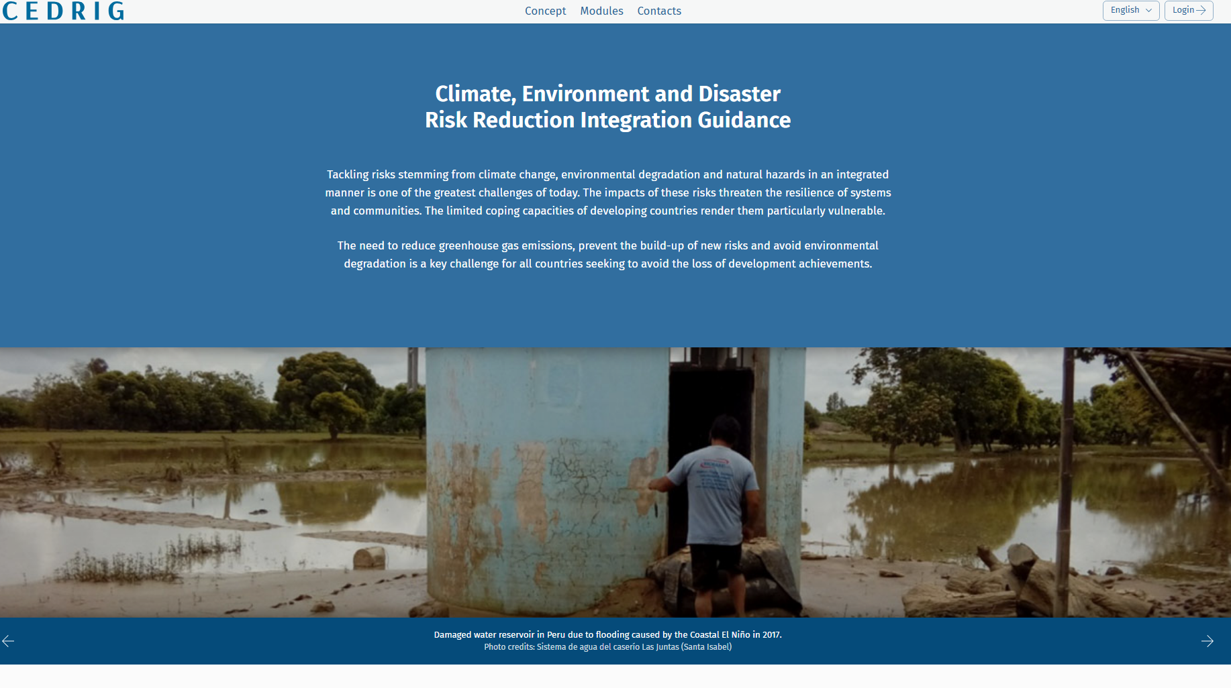
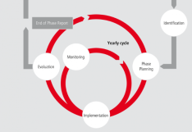
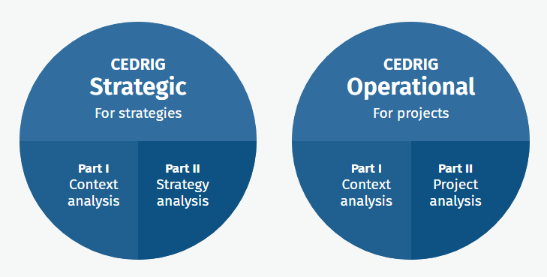
CEDRIG: Website and tool
www.cedrig.org
CEDRIG tool
Country
Strategies / Programmes
Project
Basic information on CEDRIG
Access to the CEDRIG tool
Depository of CEDRIG studies
Notes:
The CEDRIG tool has two modules:
CEDRIG Strategic for strategies and programmes
CEDRIG Operational for projects

Slide 7
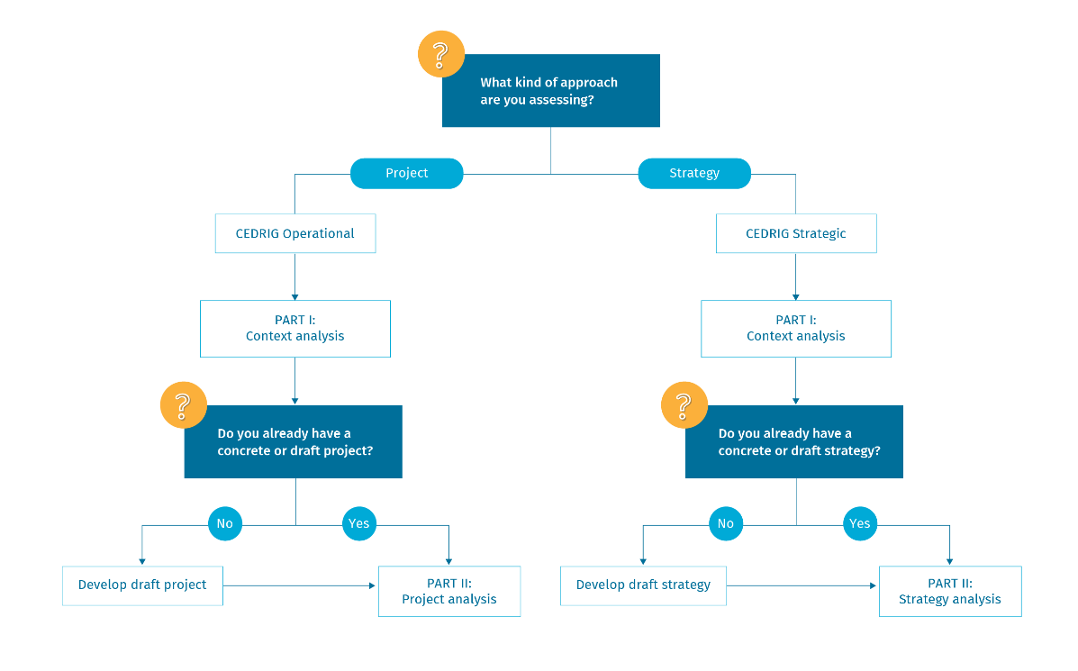
CEDRIG: Decision tree
CEDRIG Operational applies to projects and programmes.
CEDRIG Strategic applies to country and domain strategies, cooperation frameworks, and programme frameworks
Notes:
Depending on whether you would like to assess a strategy or a project, you conduct a CEDRIG Strategic or Operational Study. In either case, you start with part I, which is the context analysis. Part II then builds on that context analysis and looks at the interaction of your project/strategy with the context of CDE. Part II, however, can only be conducted if a concrete or draft project/strategy exists.

Slide 8
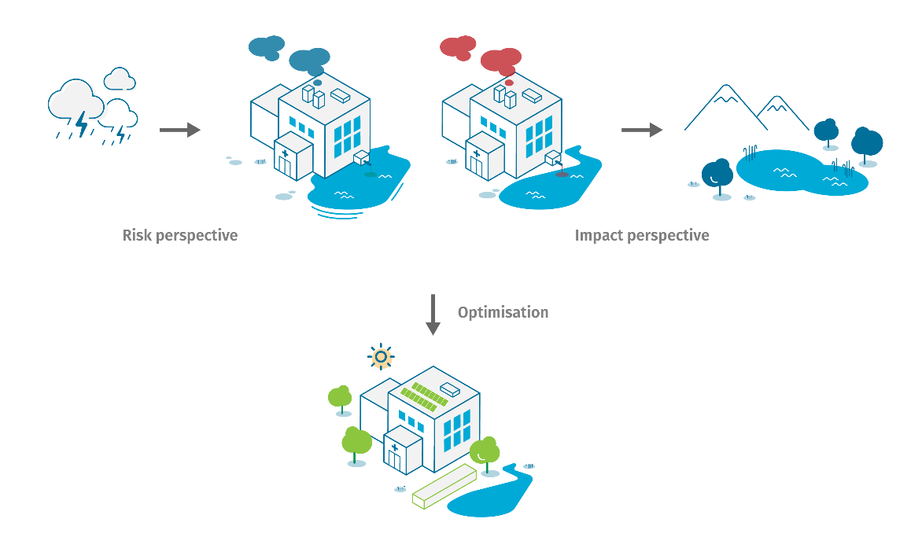
CEDRIG: A triple perspective approach
Notes:
Risk perspective: Determine whether or not project goals, aims or priorities are at risk from climate change, environmental issues or natural hazards
Impact perspective: determine whether the project may have adverse effects on the climate or the environment, or whether it creates or exacerbates risks
Optimisation: Adjust your project/strategy to integrate climate change, disaster risk reduction and the environment (C/D/E) into your activities, capture entry points for the creation of positive impacts on C/D/E, and create and make use of synergies and co-benefits with existing initiatives, projects and actors.

Slide 9

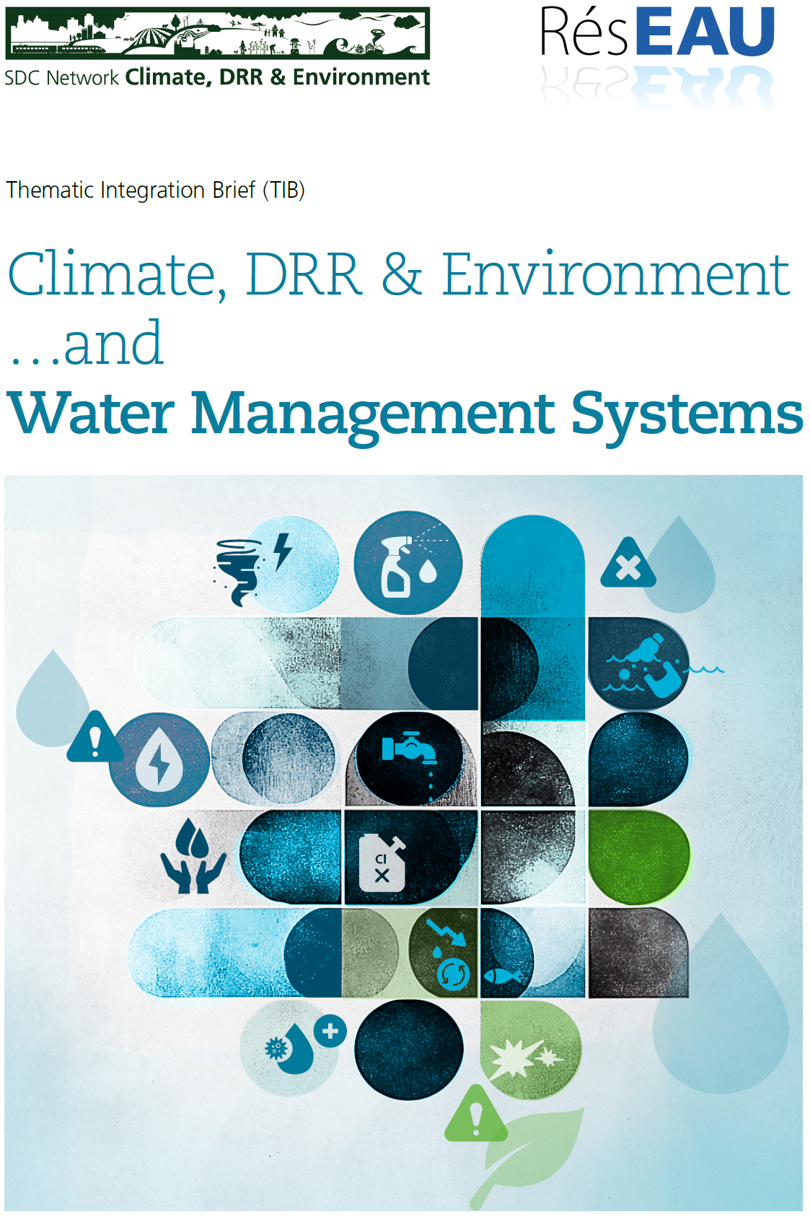
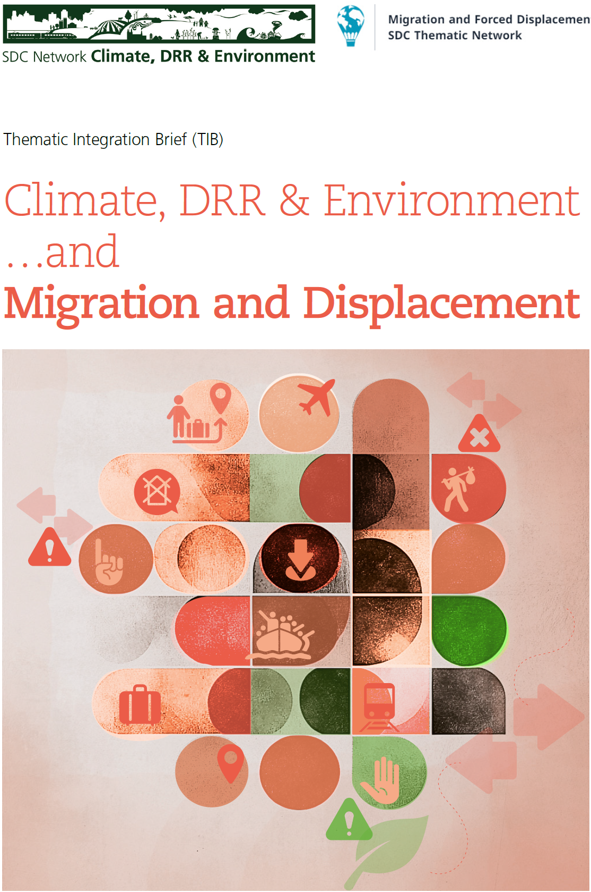

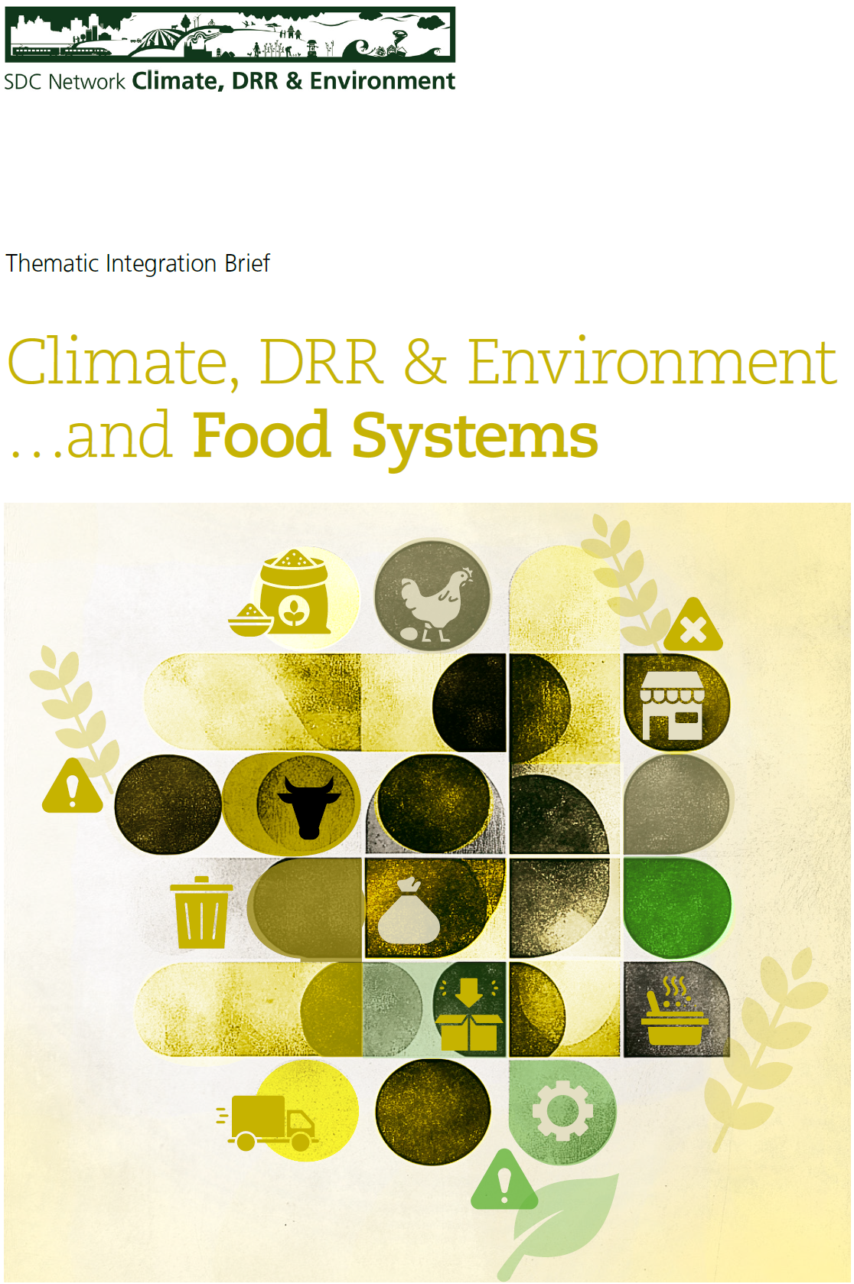
Thematic Integration Briefs (TIBs)
→ Additional resources; currently available (CEDRIG / CDE knowledge PF):
Similar products planned for E+E, fragile contexts, gender, governance.
Notes:
Thematic Integration Briefs (TIBs) are structured along the CEDRIG approach, and provide compilations of the interrelations between a development sector, and climate change, disaster risk and the environment (C/D/E). The TIBs may give inspiration, and are meant to support the CEDRIG way of thinking about these interrelationships in all modules, and all steps of the studies. The aims are to:
Help users understand the potential risks for a sector, project or system
Highlight possible adverse impacts of development sectors on climate, disaster risk and the environment
Offer practical advice on options for integrating C/D/E considerations into the sector of interest, and show how to add value, assure greening, and risk-proof the sector

Slide 10
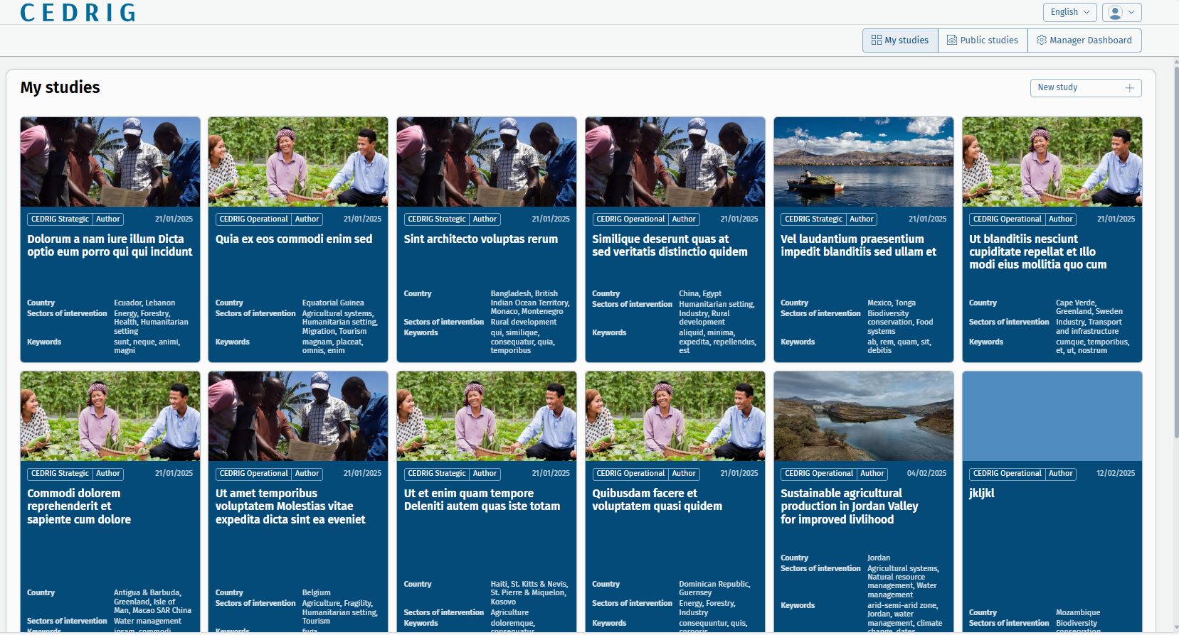
CEDRIG: Overview
Notes:
This is how the landing page of the CEDRIG tool will look like once there are public studies.

Slide 11
Methodical intro – Different ways of conducting a CEDRIG workshop
General introduction to CEDRIG workshop: Participants gain knowledge and insights on the aim and logic of CEDRIG, including the two modules and different work steps. They apply CEDRIG Operational in a training context, on the basis of case studies.
CEDRIG Operational workshop: Participants conduct a CEDRIG assessment of specific planned or ongoing project(s). The workshop serves to work on (parts of) the CEDRIG process (and to validate other parts that have already been worked on by the project, a consultant, etc.).
CEDRIG Strategic workshop: Participate conduct a CEDRIG assessment of their planned or ongoing strategy. The workshop is mainly used to validate and discuss work prepared on Part I and II (at least until risk and impact overview) with management level, and identify optimisation measures.

Slide 12
Methodical intro – How to conduct a CEDRIG introductory / Operational workshop
Preparatory phase
Prepare concept, draft programme and screenplay
Workshop phase
Work in small groups (3-4 persons); one large screen per group is an asset
Debriefing phase
What went well, where is room for improvement for future workshops
Allocate enough time for the workshop (min 2-3 days excl. travelling)
Invite the participants (and enough trainers)
Prepare all the logistics
Know your context (external consultant needed?)
Be interactive
Needs for improvement for the tool? Let us know!

Slide 13
Methodical intro – How to conduct a CEDRIG Strategic workshop
Preparatory phase
Prepare concept, draft programme and screenplay
Workshop phase
Validate assessment that has been done ahead of the workshop
Debriefing phase
What went well, where is room for improvement for future workshops
Allocate enough time for the workshop (around 1 day)
Invite the participants (and enough trainers)
Prepare all the logistics
Prepare Part I and Part II (Steps 1 and 2) of CEDRIG Strategic ahead of the workshop
Be interactive
Needs for improvement for the tool? Let us know!
Work in small groups (3-4 persons); one large screen per group is an asset

Slide 14
CEDRIG Operational: Overview

Slide 15
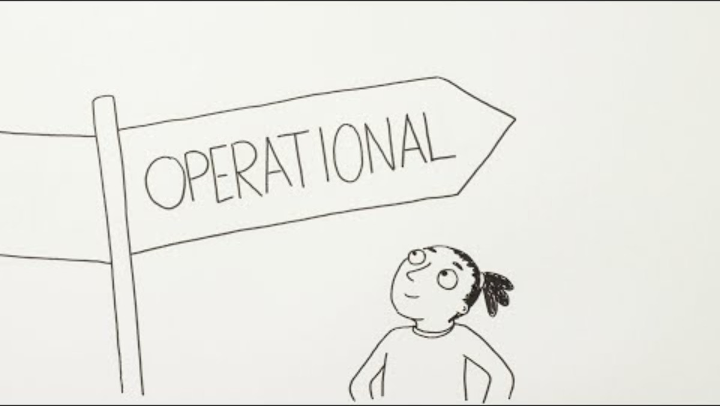
CEDRIG Operational: Introduction

Slide 16
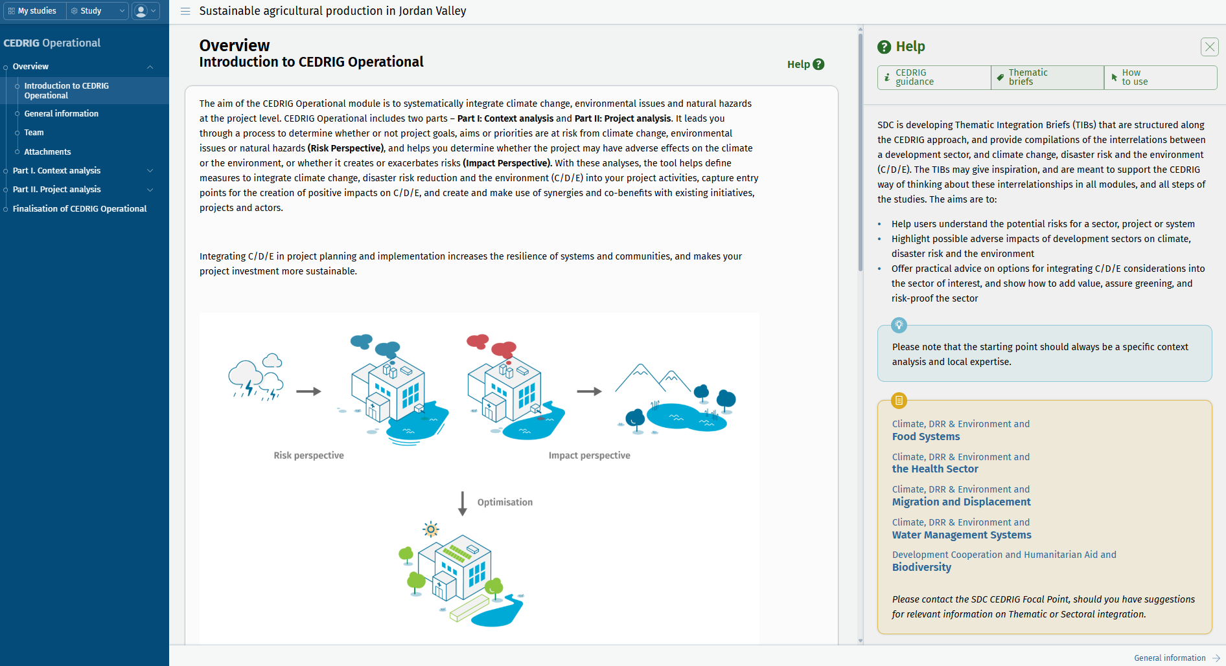
CEDRIG Operational: Overview

Slide 17
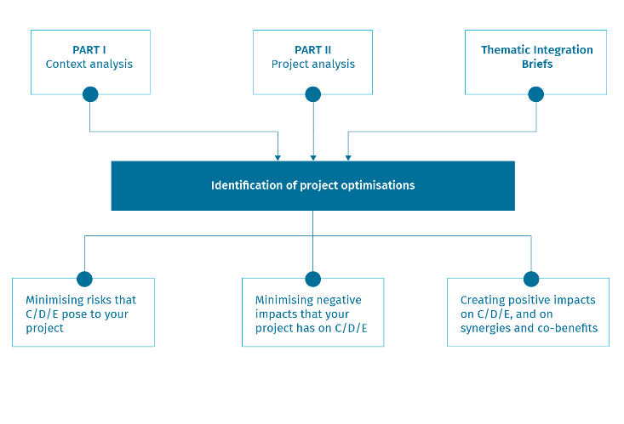
CEDRIG Operational
Operational projects, programmes, etc.
Ongoing or ideally planning stage (or mid-term review)
Involve key responsible staff & partners (> multistakeholder workshop)
Typically 2-3 days incl. field visit
Intro-movie: https://youtu.be/rV7zxQ4UaqE

Slide 18
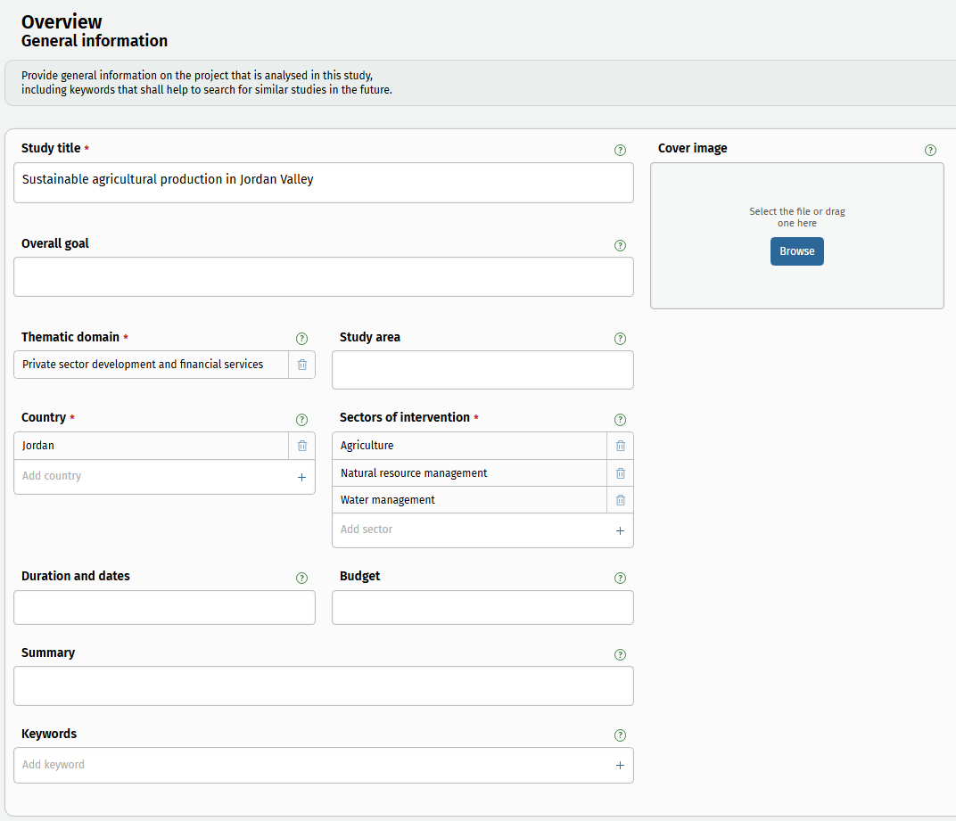
CEDRIG Operational
Getting started with some basic information

Slide 19
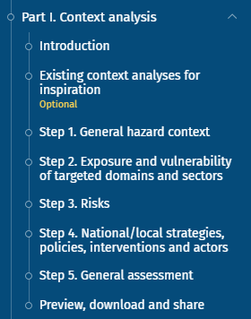
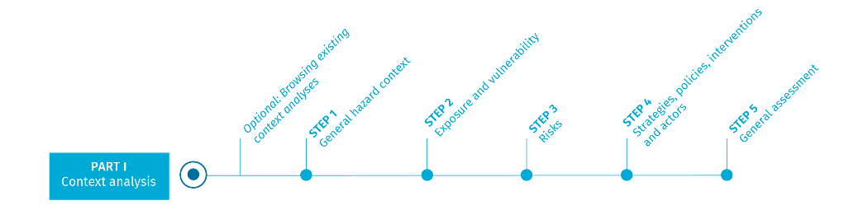
Part I: Context analysis
Sound context analysis as basis for systematic C/D/E integration – importance cannot be underestimated
Newly integrated into the tool – but no relevant content change to old CEDRIG
How to get there:
Recycle (use/adapt an existing context analysis)
Outsource (> consultant)
Do it yourself
Notes:
CEDRIG Operational includes 2 parts.
Part I is the Context analysis
On the left side, you see the navigation tree of part I which guides you through it.

Slide 20
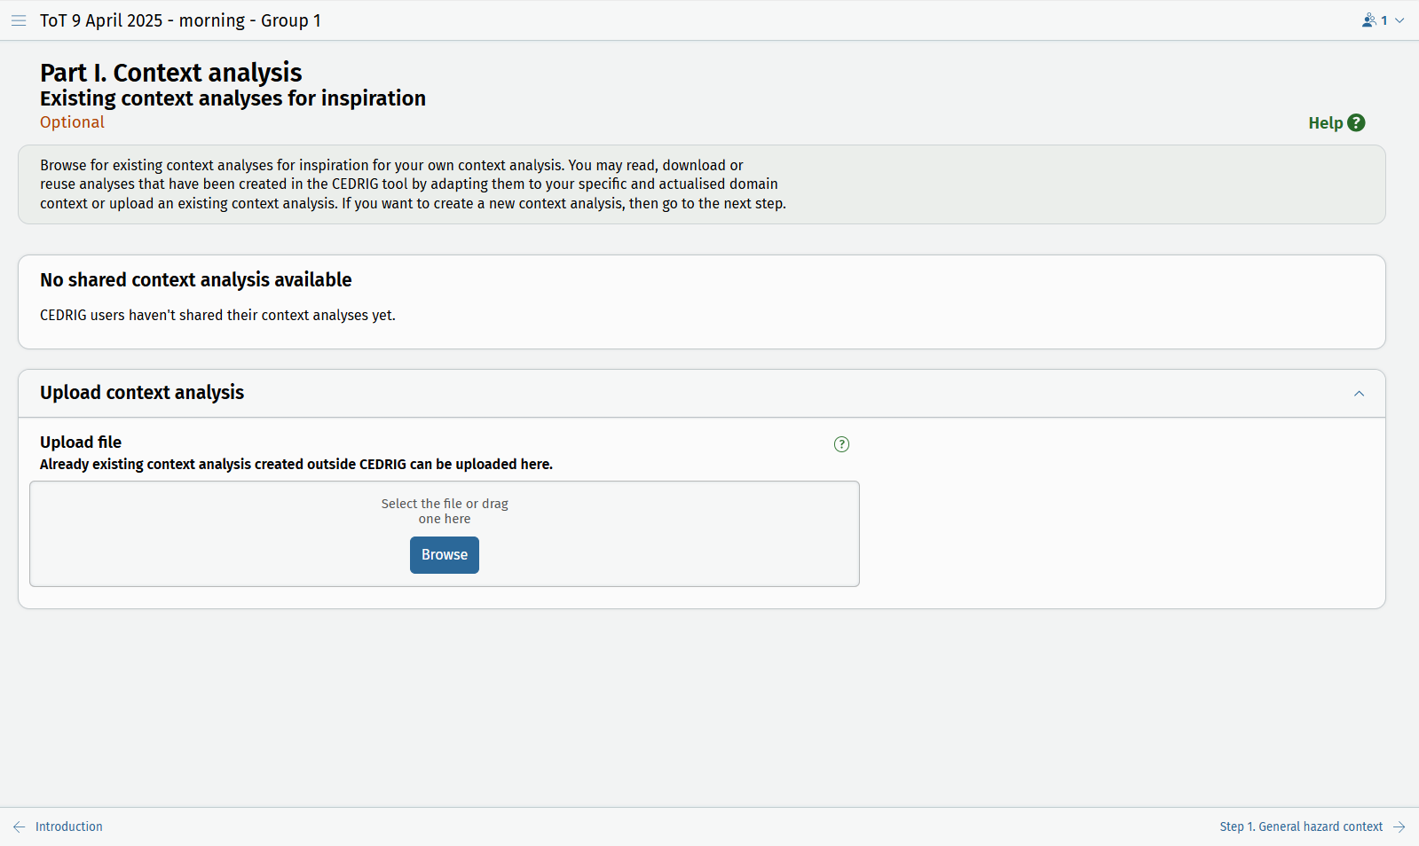
Part I: Context analysis
Recycle / adapt an existing context analysis
Create a new context analysis (by yourself or through a consultant)

Slide 21
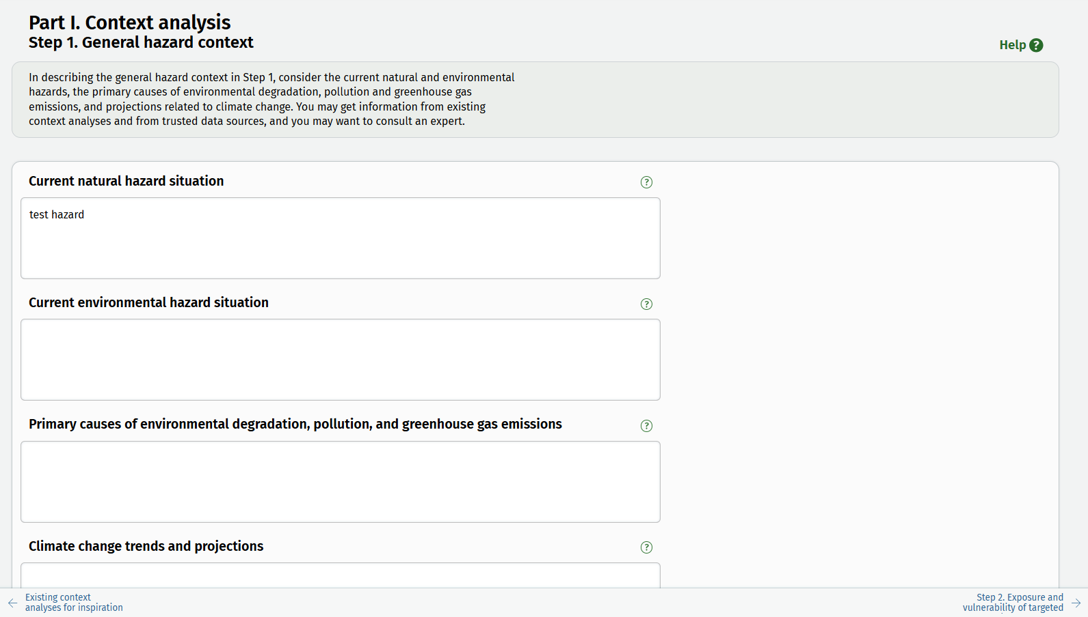
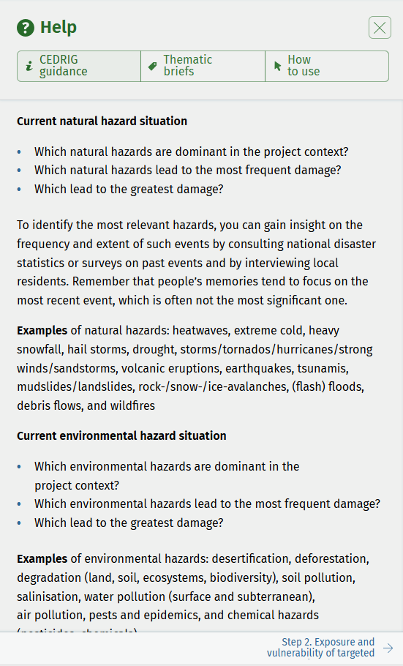
Part I: Context analysis
Background information and guidance (compilation will be available as manual)
Specific information, examples, definitions or data source related to this topic

Slide 22
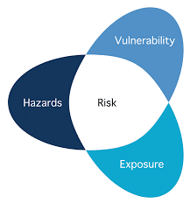
Context analysis – hazards, vulnerabilities, risks
Hazard: A process, phenomenon or human activity that may cause loss of life, injury or other health impacts, property damage, social and economic disruption or environmental degradation. Focus in CEDRIG: natural and environmental hazards as well as future trends due to climate change.
Exposure: The presence of people; livelihoods; environmental services and resources; infrastructure; or economic, social, or cultural assets in places that could be adversely affected.
Vulnerability: The propensity or predisposition to be adversely affected.
Source: IPCC AR5 Conceptual Framework; see also: Managing the Risks of Extreme Events and Disasters to Advance Climate Change Adaptation

Slide 23
Context analysis – hazards, vulnerabilities, risks
Hazard:
Current natural hazard situation (e.g. heat wave, landslide, flood)
Current environmental hazard situation (e.g. desertification, deforestation, pollution) and their primary causes (including greenhouse gas emissions)
Future climate change trends
Exposure:
Description of exposure to hazards (e.g. people, property, systems (incl. critical infrastructure)
Vulnerability:
Vulnerability to hazards (including physical factors (e.g. infrastructure vulnerabilities), social factors (e.g. poverty, inequality, lack of access to services or informal networks, etc.), economic factors (e.g. lack of (access to) resources, vulnerable livelihoods), environmental factors (e.g. overexploitation of natural resources)
Risk: f (hazard, exposure, vulnerability)
Notes:
Risks: a qualitative description of the interplay of hazards, exposure and vulnerability

Slide 24
Context analysis – (national) strategies, policies, actors
Strategies and policies:
All official documents and plans related to climate change, environment, DRR, etc.
Interventions incl lessons learnt:
Relevant interventions from SDC and other actors incl. lessons learnt
Actors:
Major actors, priorities, funds?

Slide 25
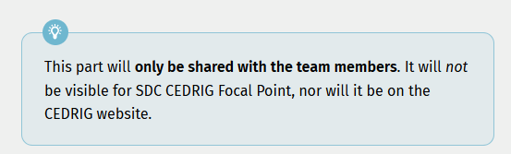
Context analysis – General assessment
You may use this page as an internal assessment:
Your general understanding of hazards, vulnerabilities, coping capacities, strategies and lessons learned by other actors
Your understanding of the efficiency of strategies
Your initial thoughts on possible options to join forces with existing initiatives, or the need for tackling identified gaps

Slide 26
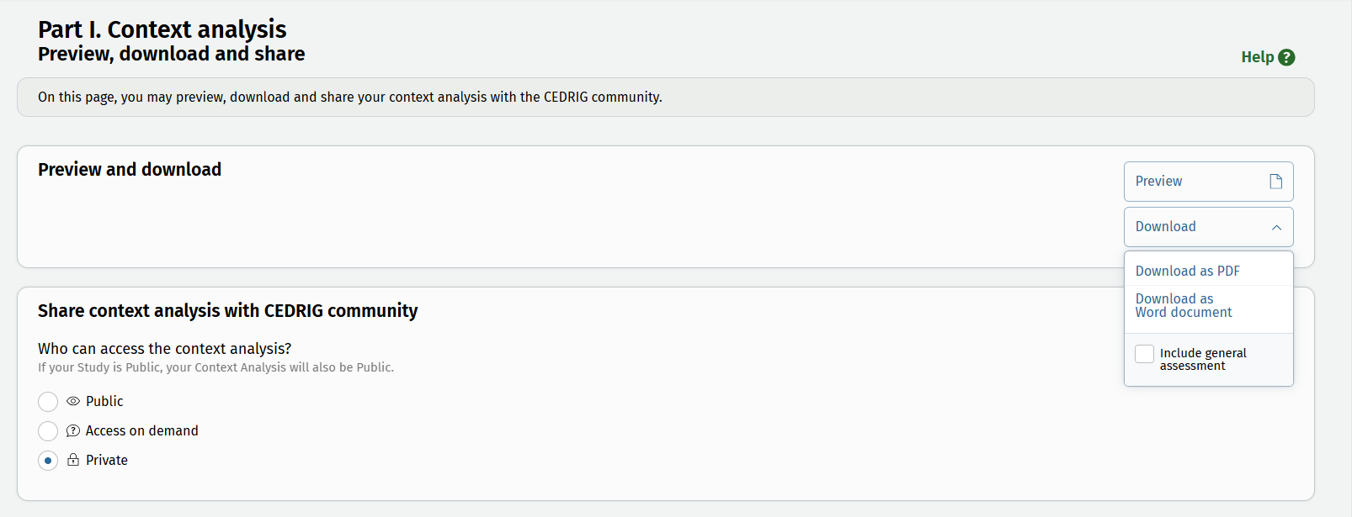
Context analysis – Preview, download and share

Slide 27
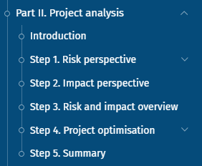
Part II: Project analysis
CEDRIG follows a risk perspective (step 1) and an impact perspective (step 2).
Tool focuses on informed proactive project optimisations with a CDE lens that focus also on opportunities / co-benefits.
The project analysis can only be done if a (draft) project document exists. The context analysis and the Thematic Integration Briefs might help you to get there.
The project analysis is ideally conducted as a multi-stakeholder workshop.
Notes:
In part II, the project analysis, you analyse the risks of C/D/E on your project, and the impact of your project on C/D/E, and define measures to optimise your project.

Slide 28
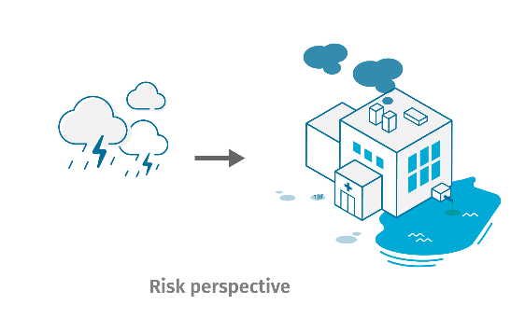
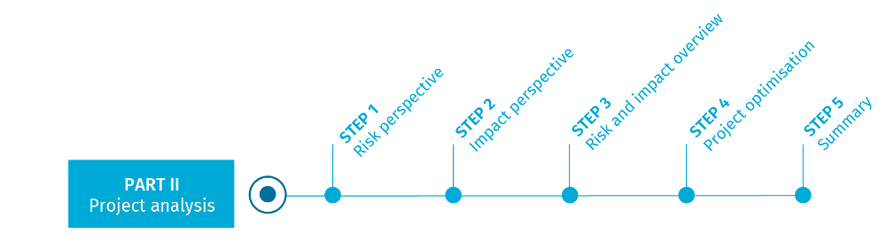
Step 1: Risk perspective

Slide 29
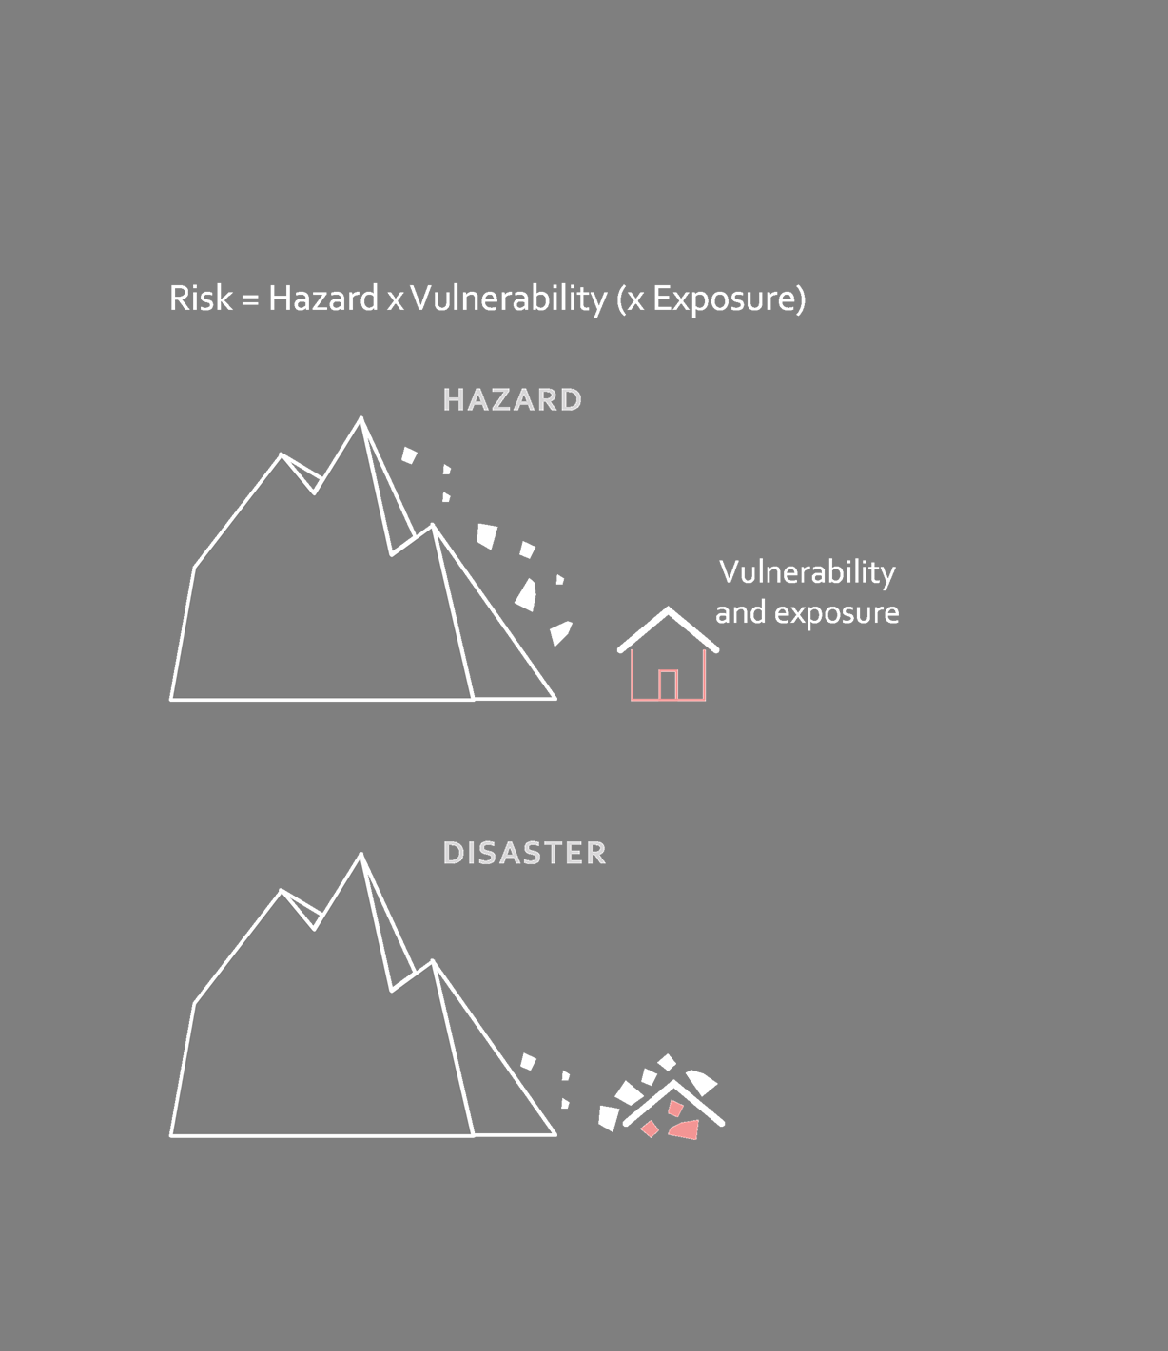
Risk = Hazard x Vulnerability (x Exposure)
Focus: exposed project component
Notes:
The potential damage depends on the size of the natural event, as well as the value, vulnerability and probability of presence.
Damage occurring = number of deaths & economic losses.
Many events cannot be influenced: Geophysical: earthquakes, volcanic eruptions, tsunamis
However, we can influence the damage they cause.
Natural disasters are not simply a result of a natural event, but a reaction
Vulnerability is also often a function of poverty. Poor people are pushed into less safe areas and are far more exposed to a natural event than (often better protected) wealthy sections of the population. Governance and development play an important role.

Slide 30
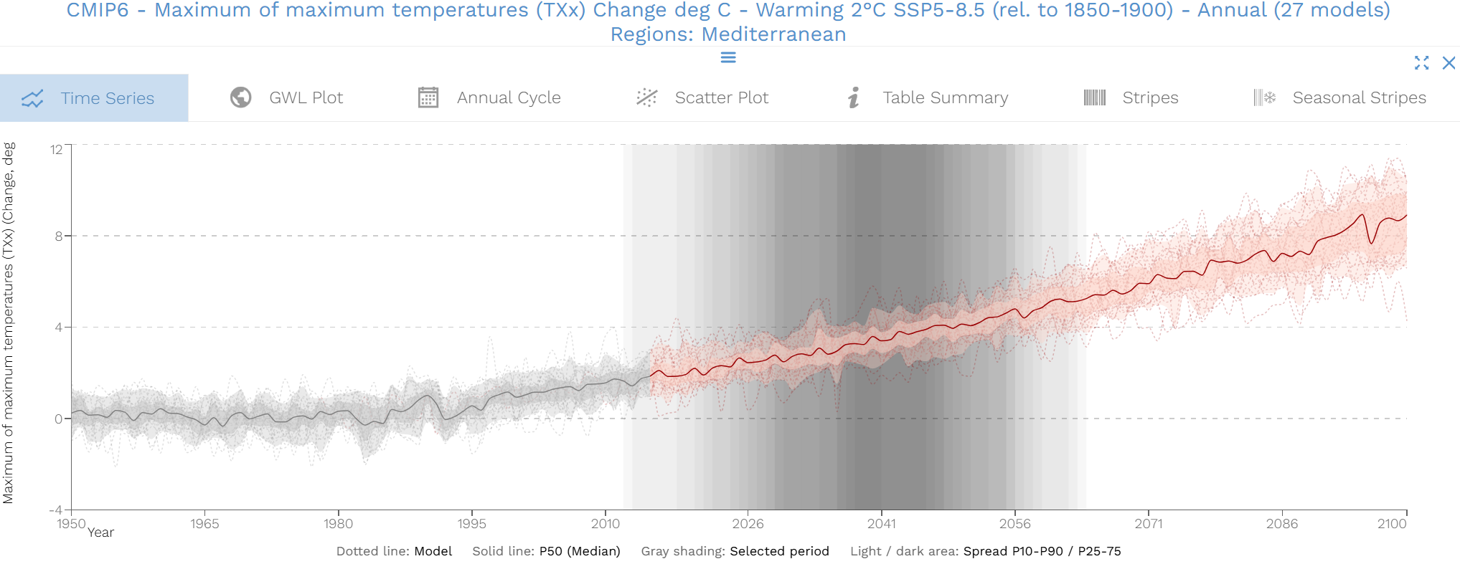
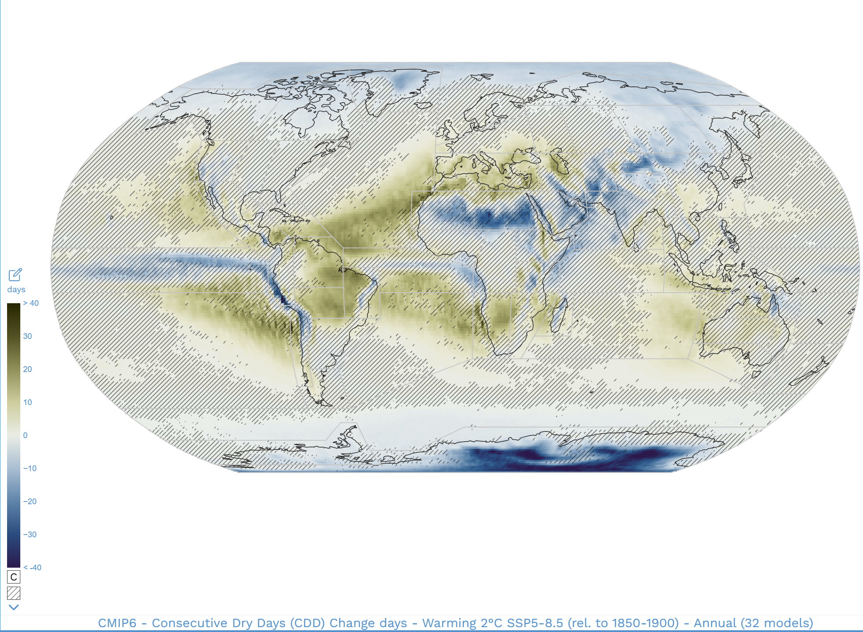
Identify relevant climate trends
Source: https://interactive-atlas.ipcc.ch/

Slide 31
Assess hazards and vulnerabilities
Questions to be adressed | Examples
Potential consequences for each identified hazard? | Decrease in crop yield Damage to infrastructure Quality degradation of forests and soils
Vulnerability & Exposure | Limited amount of water for irrigation in project area Poorly built infrastructure; low level of preparedness, no social safetynet
Vulnerability evaluation | Low Medium High

Slide 32
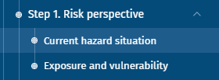
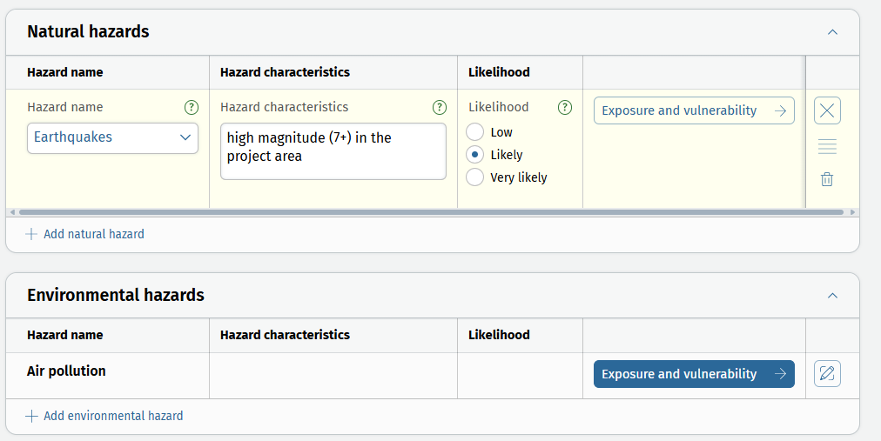
Step 1: Risk perspective - layout
Table format – focused on hazards

Slide 33
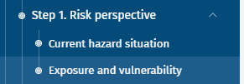
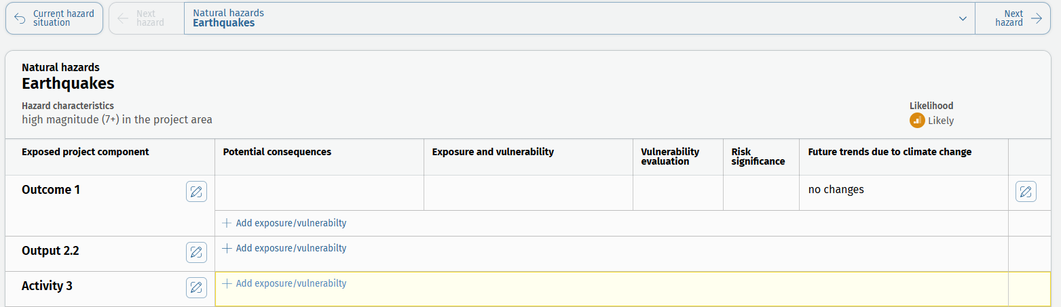
Step 1: Risk perspective - layout
Hazard-specific tables
Navigation through hazards via dropdown or by clicking on “next / previous hazard”. Button on the bottom of the page to “Go to risk and impact overview”

Slide 34
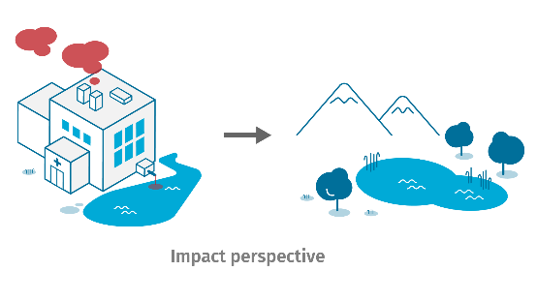
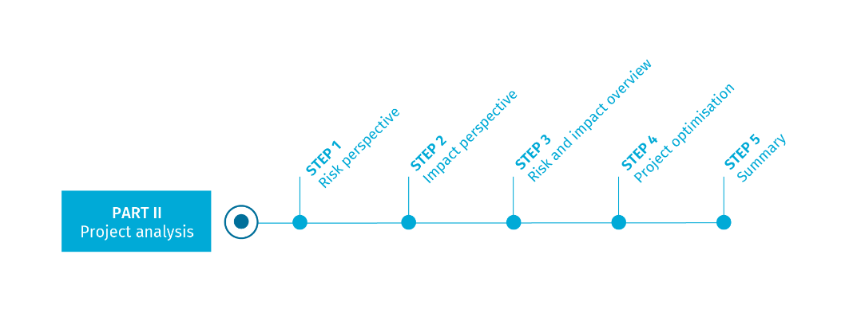
Step 2: Impact perspective
34

Slide 35
Step 2: Impact perspective
Identify project components with potential impacts on climate, disaster risk, and/or the environment
Estimate the significance of the potential negative impacts identified
Think about potential project optimisation measures
Reminder:
CEDRIG does not provide a full-fledged Environmental Impact Assessment

Slide 36
Step 2: Impact perspective - Examples
Photovoltaic powered ground-water pump (risk of aquifer depletion due to cheap energy)
Food systems / value chain: food processing including plastic packaging (potential solid waste problem)
Infrastructure expansion in flood plain (increased risk due to increased vulnerability)

Slide 37

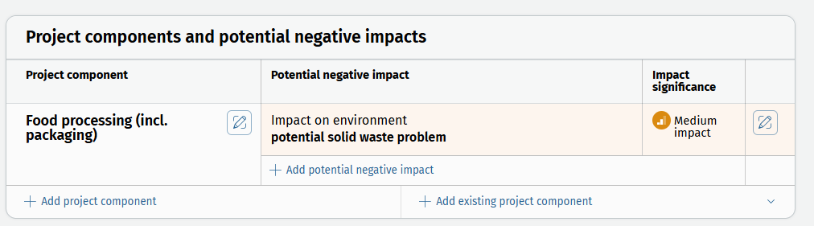
Step 2: Impact perspective – layout
Project component-oriented table
Button on the bottom of the page to “Go to risk and impact overview” – get back by clicking on the same button again

Slide 38
Part II: Steps 3 - 5

Slide 39
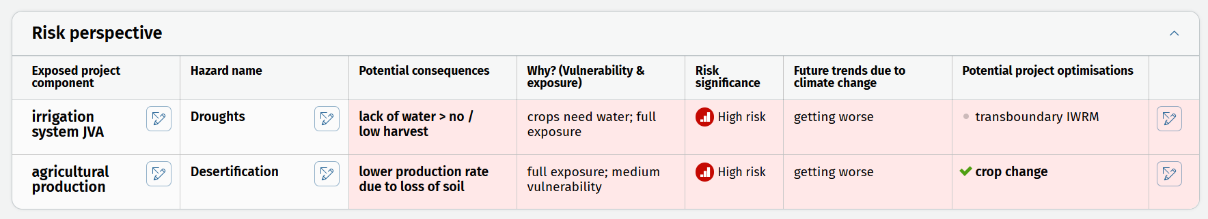
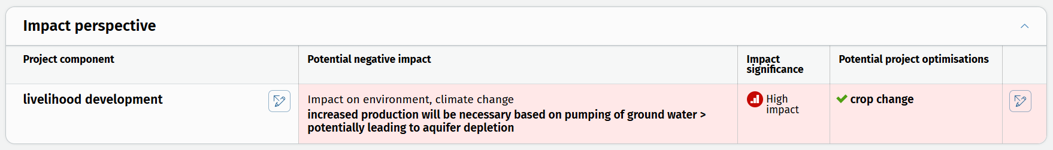
Step 3: Risk and impact overview
Key product for development of project optimisations
Tables are project component oriented
Tables include information from steps 1, 2 and are updated with results from step 4 and serve as a final product

Slide 40
Step 4: Project optimisation
Address risks
Address impacts
Think about co-benefits!
For the development of project optimisations, use:
Context analysis
Risk and impact table
Thematic Integration Briefs

Slide 41
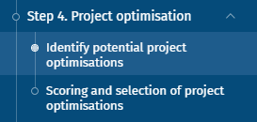
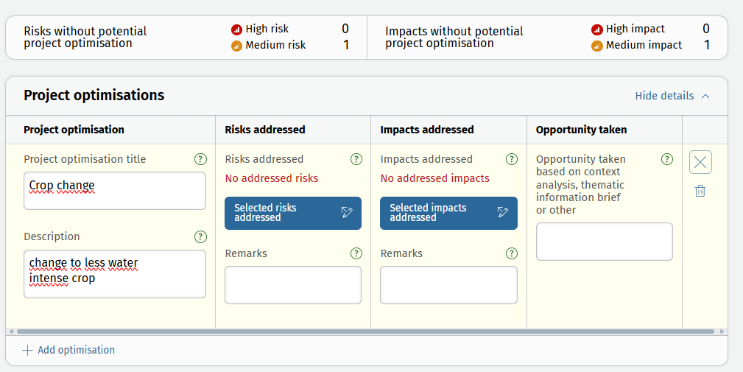
Step 4: Project optimisation – layout
Select or describe selected risks and impacts
Overview at the top shows how many risks / impact have not been addressed yet

Slide 42
Step 4: Project optimisation – scoring and selection
Possibility to score project optimisations (optional)
Scoring criteria
Resilience effectiveness
Cost / Benefit
Feasibility
Acceptability
Sustainability
Custom scoring criterion can be added
Custom scoring can be uploaded
Important: Click «confirm scoring» or «skip scoring» to move to the selection of project optimisations.
Select which optimisations shall be implemented. For unselected optimisations, an explanation is required under selection remarks.

Slide 43
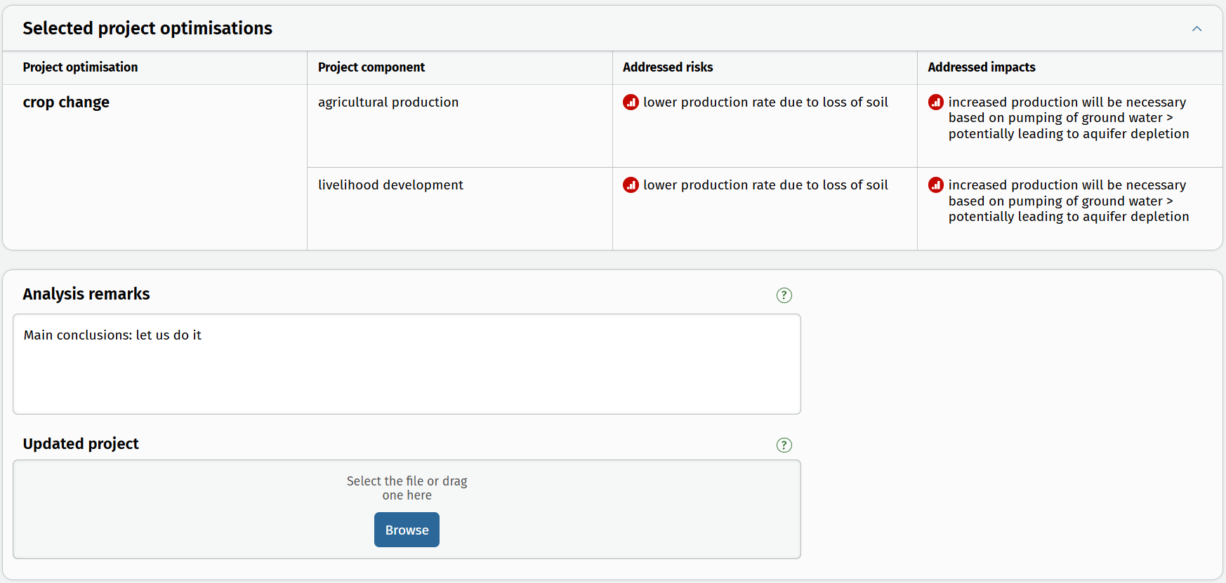
Step 5: Summary - layout

Slide 44
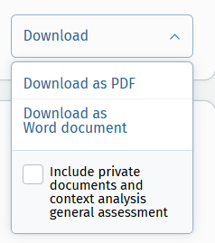
Finalisation of CEDRIG Operational
Study preview (report)
Study download (as PDF, as a Word document; including private documents, context analysis and general assessment or not)
Share your study with CEDRIG community?

Slide 45
CEDRIG Strategic: Overview

Slide 46
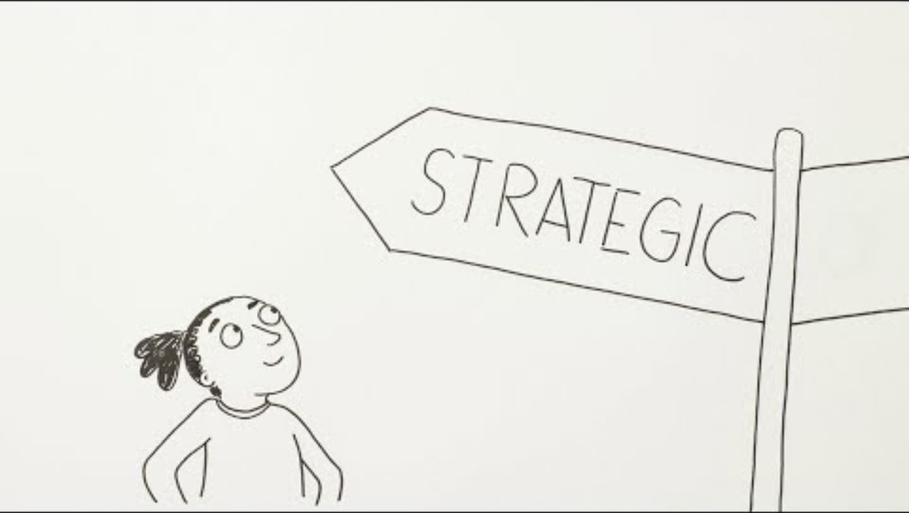
CEDRIG Strategic: Introduction

Slide 47
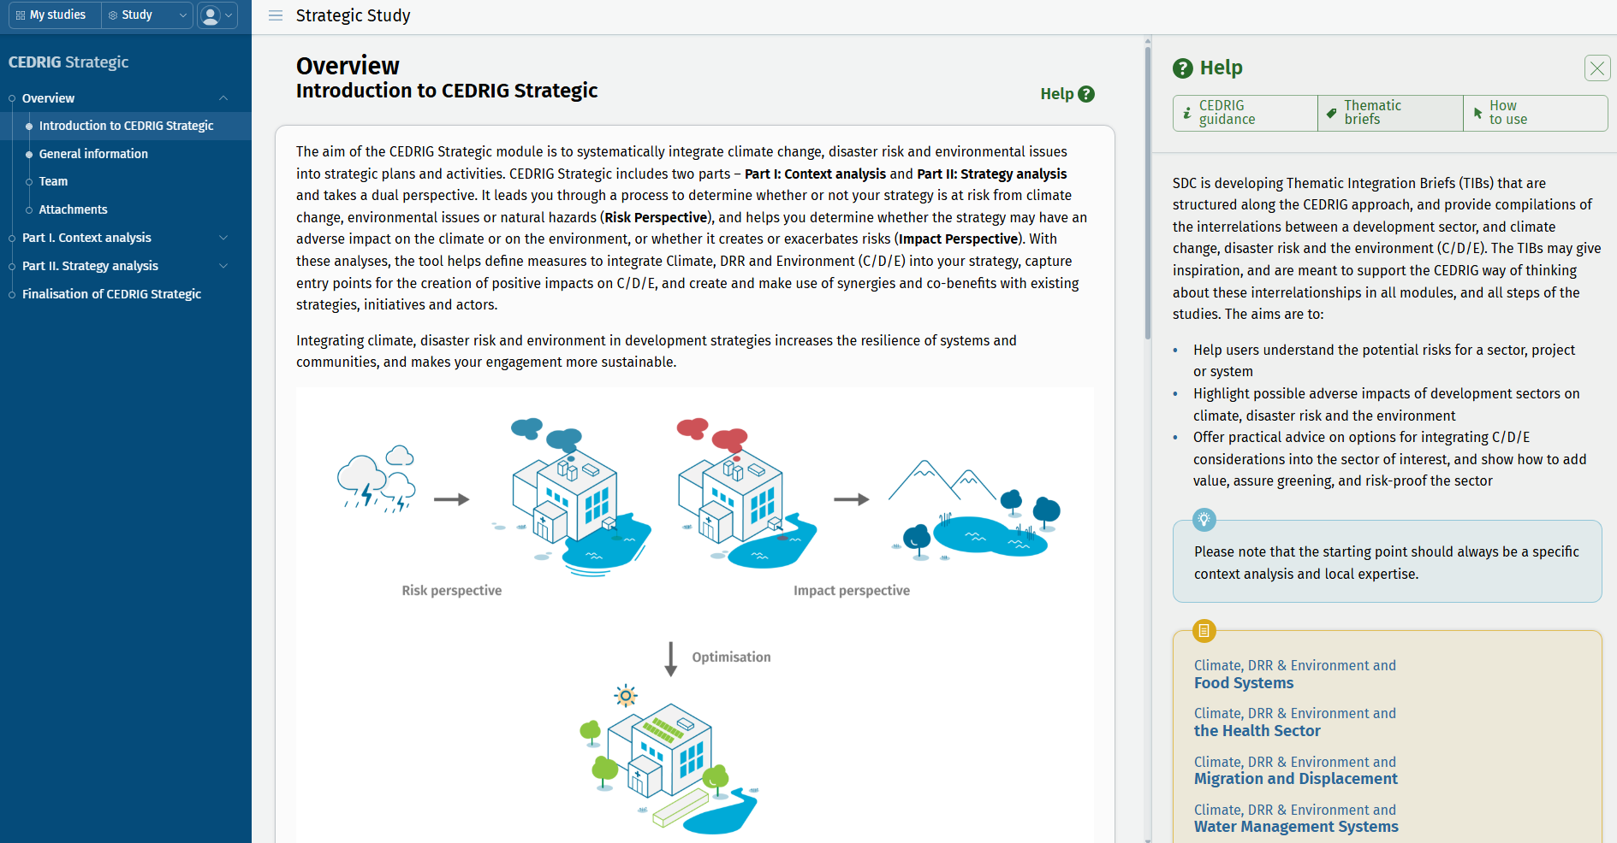
CEDRIG Strategic: Overview

Slide 48
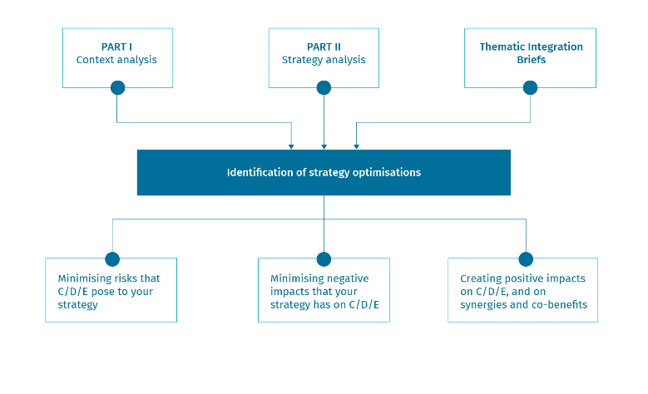
CEDRIG Strategic
Strategic approaches, incl. country strategies, domain strategies, cooperation frameworks, programme frameworks
Planning stage or mid-term review
Involve key responsible staff & partners (> multi-stakeholder workshop)
Intro-movie: https://youtu.be/3CvD4nuucqY

Slide 49
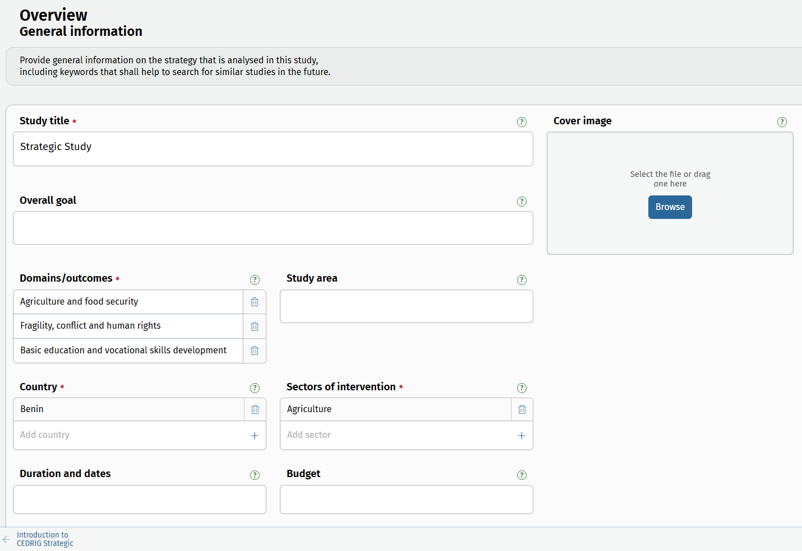
CEDRIG Strategic
Getting started with some basic information

Slide 50
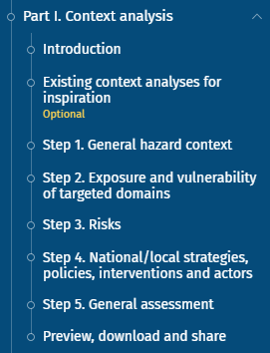
Part I: Context analysis
Sound context analysis as basis for systematic C/D/E integration – importance cannot be underestimated
Newly integrated into the tool – but no relevant content change to old CEDRIG
How to get there:
Recycle (use/adapt an existing context analysis)
Outsource (> consultant)
Do it yourself
Notes:
CEDRIG Strategic includes 2 parts.
Part I is the Context analysis
On the left side, you see the navigation tree of part I which guides you through it.

Slide 51
Part I: Context analysis
Recycle / adapt an existing context analysis
Create a new context analysis (by yourself or through a consultant)

Slide 52
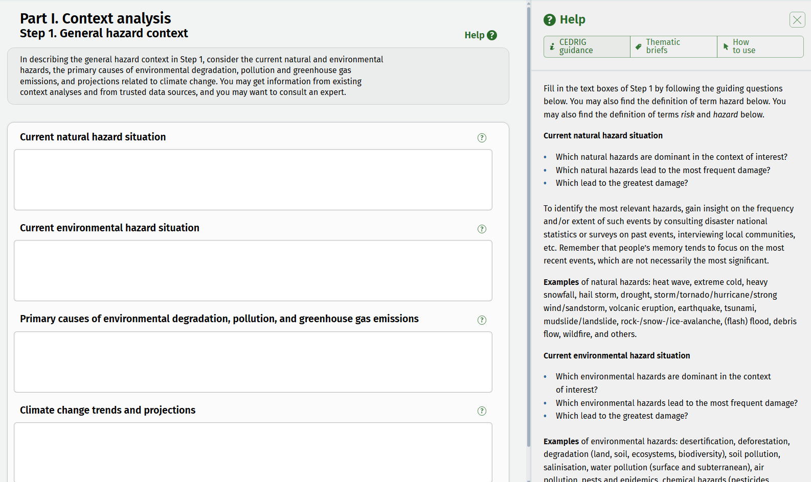
Part I: Context analysis
Background information and guidance (compilation will be available as manual)
Specific information, examples, definitions or data source related to this topic

Slide 53
Context analysis – hazards, vulnerabilities, risks
Hazard: A process, phenomenon or human activity that may cause loss of life, injury or other health impacts, property damage, social and economic disruption or environmental degradation. Focus in CEDRIG: natural and environmental hazards as well as future trends due to climate change.
Exposure: The presence of people; livelihoods; environmental services and resources; infrastructure; or economic, social, or cultural assets in places that could be adversely affected.
Vulnerability: The propensity or predisposition to be adversely affected.
Source: IPCC AR5 Conceptual Framework; see also: Managing the Risks of Extreme Events and Disasters to Advance Climate Change Adaptation

Slide 54
Context analysis – hazards, vulnerabilities, risks
Hazard:
Current natural hazard situation (e.g. heat wave, landslide, flood)
Current environmental hazard situation (e.g. desertification, deforestation, pollution) and their primary causes (including greenhouse gas emissions)
Future climate change trends
Exposure:
Description of exposure to hazards (e.g. people, property, systems (incl. critical infrastructure)
Vulnerability:
Vulnerability to hazards (including physical factors (e.g. infrastructure vulnerabilities), social factors (e.g. poverty, inequality, lack of access to services or informal networks, etc.), economic factors (e.g. lack of (access to) resources, vulnerable livelihoods), environmental factors (e.g. overexploitation of natural resources)
Risk: f (hazard, exposure, vulnerability)
Notes:
Risks: a qualitative description of the interplay of hazards, exposure and vulnerability

Slide 55
Context analysis – (national) strategies, policies, actors
Strategies and policies:
All official documents and plans related to climate change, environment, DRR, etc.
Actors:
Major actors, priorities, funds?

Slide 56
Context analysis – General assessment
You may use this page as an internal assessment:
Your general understanding of hazards, vulnerabilities, coping capacities, strategies and lessons learned by other actors
Your understanding of the efficiency of strategies
Your initial thoughts on possible options to join forces with existing initiatives, or the need for tackling identified gaps
Other ideas or concerns

Slide 57
Context analysis – Preview, download and share

Slide 58
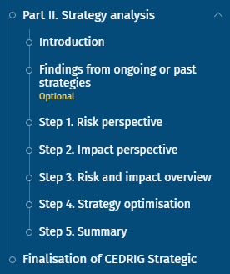
Part II: Strategy analysis
CEDRIG follows a risk perspective (step 1) and an impact perspective (step 2).
Tool focuses on informed proactive strategy optimisations with a CDE lens that focus also on opportunities / co-benefits.
The strategy analysis can only be done if a (draft) strategy document exists. The context analysis and the Thematic Integration Briefs might help you to get there.
The strategy analysis is ideally conducted as a multi-stakeholder workshop.
Notes:
In part II, the strategy analysis, you analyse the risks of C/D/E on your strategy, and the impact of your strategy on C/D/E, and define measures to optimise your strategy.

Slide 59
Optional: Collect findings from ongoing or past strategies
To prepare for Part II, the strategy analysis, you may extract findings and lessons learned from past or ongoing strategies.
Guiding questions are:
How have we made sure in the past to address C/D/E?
Are we already implementing parts of C/D/E jointly with other actors and could we strengthen some of these?
What has worked well in the past, what has not worked? Are there any lessons learned?
You may get assistance from an external consultant for this step.

Slide 60
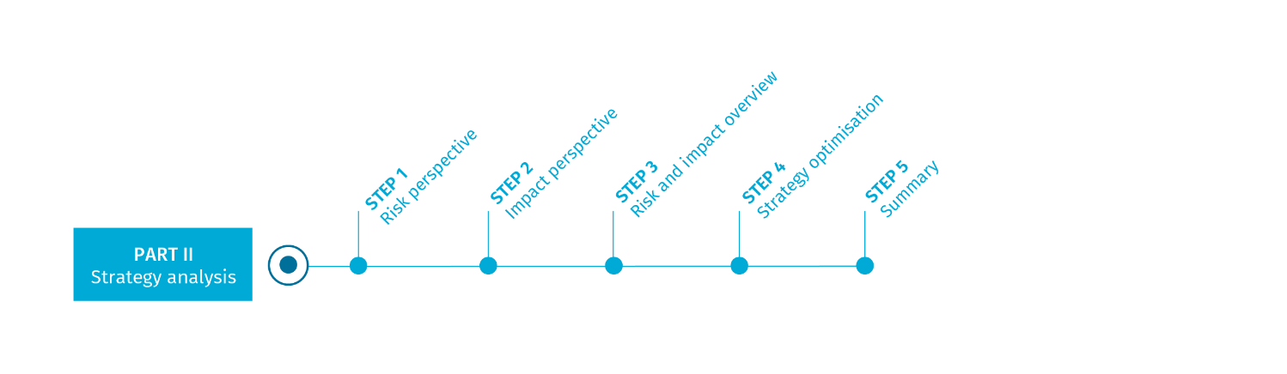
Step 1: Risk perspective

Slide 61
Risk = Hazard x Vulnerability (x Exposure)
Focus: exposed strategy component
Notes:
The potential damage depends on the size of the natural event, as well as the value, vulnerability and probability of presence.
Damage occurring = number of deaths & economic losses.
Many events cannot be influenced: Geophysical: earthquakes, volcanic eruptions, tsunamis
However, we can influence the damage they cause.
Natural disasters are not simply a result of a natural event, but a reaction
Vulnerability is also often a function of poverty. Poor people are pushed into less safe areas and are far more exposed to a natural event than (often better protected) wealthy sections of the population. Governance and development play an important role.

Slide 62
Identify relevant climate trends
Source: https://interactive-atlas.ipcc.ch/

Slide 63


Step 1: Risk perspective - layout
Notes:
First, you need to define the risks that are relevant to your strategy.
You may import risks from your context analysis

Slide 64

Step 1: Risk perspective - layout
Notes:
Alternatively, you can add new risks.

Slide 65

Step 1: Risk perspective - layout
Table structured along risks
Assess how the risks identified may affect your strategy as a whole or particular domains and components of it

Slide 66

Step 2: Impact perspective
66

Slide 67
Step 2: Impact perspective
Identify strategy components with potential impacts on climate, disaster risk, and/or the environment
Estimate the significance of the potential negative impacts identified
Think about potential strategy optimisation measures
Reminder:
CEDRIG does not provide a full-fledged Environmental Impact Assessment

Slide 68

Step 2: Impact perspective – layout
Domain/outcome-oriented table
Button on the bottom of the page to “Go to risk and impact overview” – get back by clicking on the same button again

Slide 69

Part II: Steps 3 - 5

Slide 70

Step 3: Risk and impact overview
Key product for development of strategy optimisations
Tables are structured along domains/outcomes
Tables include information from steps 1, 2 and are updated with results from step 4 and serve as a final product

Slide 71
Step 4: Strategy optimisation
Address risks
Address impacts
Think about co-benefits!
For the development of strategy optimisations, use:
Context analysis
Risk and impact table
Thematic Integration Briefs

Slide 72

Step 4: Strategy optimisation – layout
Select or describe selected risks and impacts
Overview at the top shows how many risks / impact have not been addressed yet

Slide 73

Step 5: Summary - layout

Slide 74
Finalisation of CEDRIG Strategic
Study preview (report)
Study download (as PDF, as a Word document; including private documents, context analysis and general assessment or not)
Share your study with CEDRIG community?

